Slide 1
YUZU ASIAN KITCHEN
Website QA Audit & UX Report
Prepared by Denis Kondratev — QA & Automation, Technion TCQA46
July 2026
Notes:
This is an independent audit of the Yuzu Asian Kitchen website — not a bug list, but a product report.

Slide 2

AGENDA
What We'll Cover
01
The Product
What Yuzu is, and what makes it work
02
QA Methodology
Testing approaches, coverage, and checklists
03
Quality Snapshot
Defect statistics, severity, and distribution by area
04
Competitive Benchmarking
UI/UX comparison against key competitors
05
Recommendations & Verdict
Priority and release readiness
02 / 16
Notes:
Five sections, one final verdict on launch readiness.

Slide 3




THE PRODUCT
What Is Yuzu Asian Kitchen
A real, live ordering platform for a multi-branch restaurant — not a demo.
2 Branches
19 Categories
Delivery + Pickup
6 Languages
Rishon LeZion & Haifa
100+ menu items
Real-time availability
HE / EN / RU / FR / ES / AR
Live open/closed status, 11:00–22:00 daily
From nigiri and sashimi to ramen and hot woks
Ordering opens and closes with branch hours
Full interface localization
03 / 16
Notes:
Yuzu is two branches, nineteen menu categories, and support for six languages.

Slide 4



THE PRODUCT
Key Strengths
Strong Visual Identity & Usability
Rich Customization
Multi-Branch, Multi-Language
Secure Order Verification
Consistent cherry-blossom branding across all 6 languages and intuitive navigation.
Up to 12 sauce and add-on options on a single dish.
Branches in the center and north of the country. Available in 6 languages.
Two-factor SMS-code verification to guard against fake orders.
04 / 16
Notes:
All four blocks passed QA review — this is the foundation the rest of the audit builds on.

Slide 5


THE PRODUCT
Scope of Testing
2
6
40+
16
BRANCHES TESTED
LANGUAGES TESTED
CHECKLIST AREAS
BUGS DOCUMENTED
Rishon LeZion & Haifa
HE, EN, RU, FR, ES, AR
Usability, GUI, Security, Compatibility
Confirmed, with steps to reproduce
05 / 16
Notes:
We covered both branches, all six languages, more than forty checklist areas, and documented sixteen bugs.

Slide 6


METHODOLOGY
Testing Methodology & Approaches
Exploratory Testing
Checklist-Driven Coverage
Boundary Values & Validation
Free-form review of core scenarios: product search, cart, and checkout
40+ functional areas reviewed against the Web Site Testing Checklist standard
Deliberate edge cases: max text length, invalid characters, field limits
💻 Primary browser: Chrome | Cross-browser audit: Firefox, Safari
16 UNIQUE BUGS
06 / 16
Notes:
Three parallel approaches: exploratory testing, checklist coverage, and boundary-value validation.

Slide 7
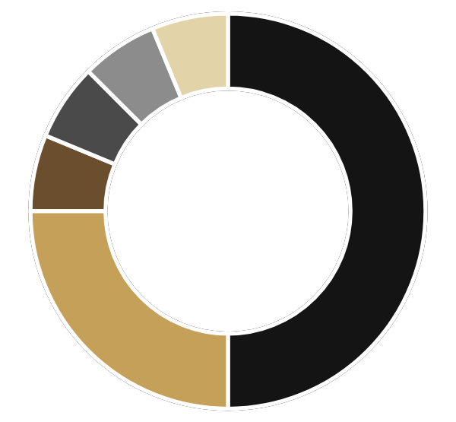
QUALITY SNAPSHOT
Distribution of Found Defects
Cart & Checkout
8
50%
Localization
4
25%
Menu
1
6%
Search
1
6%
16
Analytics
1
6%
TOTAL FINDINGS
UI/Design
1
6%
1
finding carries direct revenue impact — at the final step before payment
07 / 16
Notes:
Half of all sixteen findings live inside cart and checkout.

Slide 8
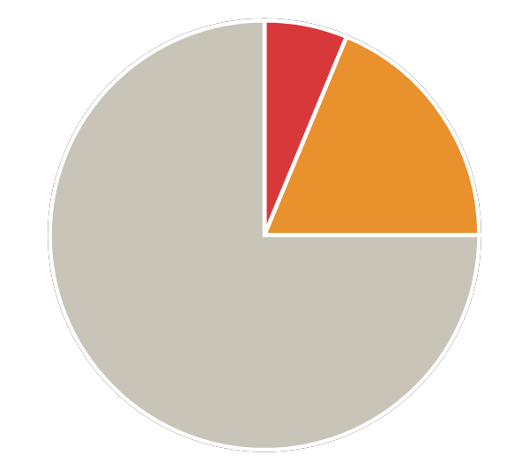







QUALITY SNAPSHOT
Defect Analysis by Severity
One high-priority issue; the rest are refinements, not a rebuild.
BY SEVERITY
BY MODULE
Critical
Cart
5
1
Localization
4
Checkout
3
High
Menu
1
3
Search
1
Medium
Analytics
1
12
UI/Design
1
Cart and Localization together account for more than 50% of all findings.
75% of defects are Medium severity (targeted UI/UX fixes, no architectural risk).
08 / 16
Notes:
Three quarters of findings are Medium severity. Cart and Localization together are more than half.

Slide 9



BENCHMARKING
Local Reference: Nini Hachi
Competitor analysis: a direct comparison of UX patterns and user feedback.
TEL AVIV, ISRAEL · PLATFORM: MISHLOHA · SUSHI & ASIAN CUISINE, DELIVERY + PICKUP
UX FEEDBACK
PROACTIVE UX
CLARITY
Explicit “Added to Cart” Confirmation
Proactive Minimum-Order Alerts
Explicit “No Results” State
A clear toast/pop-up status on every product add.
A dynamic prompt (“Add ₪12 more to reach the ₪50 minimum”).
A clear message on empty search instead of an endless loader.
Why: Removes accidental repeat clicks and user doubt.
Why: Prevents silent blocks at checkout.
Why: The user always understands the system status.
RELIABILITY
TRANSPARENCY
Correct Out-of-Stock Handling
Honest Machine-Translation Disclaimer
Out-of-stock items are clearly blocked and labeled.
Auto-translated items are labeled as such.
Why: No dead, unclickable “ghost” buttons or errors.
Why: Reduces frustration from translation errors across 6 languages.
09 / 16
Notes:
Nini Hachi in Tel Aviv — same category, but noticeably sharper feedback at every step.

Slide 10



BENCHMARKING
International Reference: The Sushi Co
A UK sushi chain — brand identity and UX work together.
UNITED KINGDOM · MODEL: MULTI-LOCATION CHAIN · “LIVE SUSHI KITCHENS,” DINE-IN + DELIVERY
CONSISTENCY
GDPR COMPLIANCE
BRAND UX
Consistent Dietary & Allergen Labeling
Granular Cookie Consent (GDPR)
Brand Values Built Into the UX
One standard of disclaimer icons (Vegetarian / Vegan / Gluten Free) across menu, site, and app.
Transparent privacy controls (Accept / Manage) instead of a vague banner.
Freshness guarantees and dish detail are woven directly into the ordering interface.
Why: Prevents selection mistakes and builds trust with dietary-restricted users.
Why: Full standards compliance and protection from legal risk.
Why: The brand shows up at every step, not just in marketing.
10 / 16
Notes:
The Sushi Co in the UK — brand and UX work together, not separately.

Slide 11
BENCHMARKING
What We'd Borrow From the Best
4 concrete, adoptable patterns — practical value grounded in the analysis.
Non-Destructive Upsell Flow
01
Reliable Full-Text Search
02
(Non-intrusive Upsell)
(Search Resilience)
Declining an upsell/cross-sell offer should never clear the cart or disrupt the user's flow.
Handles typos, transliteration, and synonyms — relevant results for any valid query.
SOURCE — NINI HACHI
SOURCE — NINI HACHI
True Content Localization
03
(Deep Localization)
Not just UI buttons — full dish descriptions, allergens, and ingredients in all 6 languages.
SOURCE — THE SUSHI CO
11 / 16
Notes:
Four patterns ready for direct adoption — each traced to a specific source.

Slide 12
CASE STUDY
Anatomy of a Critical Bug
BUG-012 · CRITICAL
One finding, traced step by step — this is what fix #1 actually looks like.
EXPECTED
STEPS TO REPRODUCE
Declining the drink should only close the modal. The previously added soup should remain in the cart, and the user proceeds to checkout.
1
Add an item with modifiers to the cart (e.g. Tom Yam Soup).
2
Confirm the sauce selection modal — the item is added to the cart (qty 1).
3
The drink upsell modal appears automatically.
ACTUAL / CRITICAL
4
Close it via the ✕ — no explicit “No thanks” button exists.
The entire cart is wiped (0 items, ₪0.00). The order is cleared with no warning, no notification, and no way to recover it.
Reproducibility: 100% (2/2 checks, no other actions in between).
13 / 16
Notes:
Here's exactly what bug #1 looks like: decline a drink upsell, and the entire cart silently empties.

Slide 13
BUSINESS IMPACT
Why It Matters
The priority fix protects revenue at the most expensive point in the funnel.
Browse
Cart
Checkout
Payment
⚠ CRITICAL DROP-OFF
💰
🛡️
Revenue Loss at Peak Conversion
At the Checkout step, the user is already ready to pay. A silent cart reset on upsell decline breaks the flow at the single most expensive moment — the customer leaves for a competitor.
Hidden Barriers for International Customers
Legal pages and key blocks appear translated but contain placeholders or incomplete translation. This lowers trust (Trust Rate) and increases churn (Churn Rate).
14 / 16
Notes:
At the last step before payment, one silent bug can empty the cart with no warning.

Slide 14
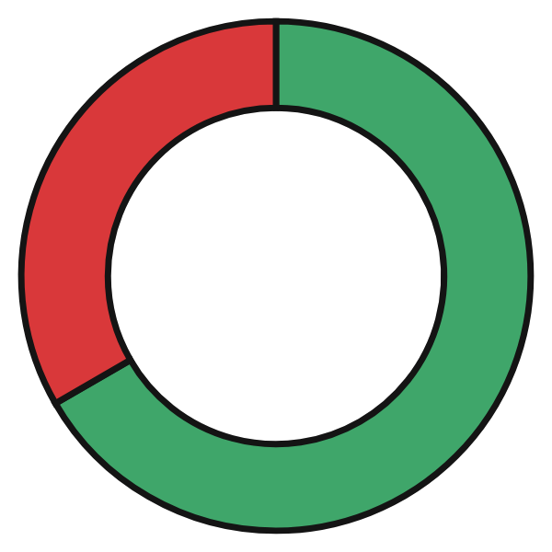
VERDICT
Conclusions & Verdict
Ready for launch with one blocking fix — not a rebuild.
LAUNCH READINESS
Content & Branding
Rich menu, accurate dish presentation, and consistent brand identity — fully production-ready.
2/3
Usability & UX
Search, feedback messages, and field validation need targeted work in the next sprint.
DIMENSIONS READY
One Blocking Item
The cart reset on upsell decline must be fixed before any public release.
Fix the Critical Bug
→
Run Regression Testing
→
Better project
15 / 16
Notes:
Verdict: the site is ready for launch as soon as the one blocking fix is in.

Slide 15
Thank You
Questions welcome.
Denis - QA & Automation, Technion TCQA46
Notes:
Thank you, happy to take questions.

